Slide 1
Wand Case Protype
John Usher
24-Mar-22

Slide 2
Overview
Design CAD for 3D printing an assembly to house 11 electronic components.
Outer dims of unit is cuboid and approx. 55x210x40 mm.
Comprises:
1. Lower box (5 sides)
2. Centre plate.
3. upper plater.
Electronic boards are mounted using screws.
Box should be approx. 3 mm thick.
Delivery are files suitable for 3D printing the components.

Slide 3
100 x 45 x 21mm
27x27
30x19
24x15
40x25
45x17.5
32x25
Screw holes
Loudspeaker
Button
33 mm O
OLED
I2S audio
Screw holes to attach top plate with case
amp
GPS
ATmega
IMU
PLED
LED
Pi-Zero: 66.0mm x 30.5mm: should be offset to allow access to USB
Hole for LED in top plate and middle plate
Hole for antenna wires
Micro USB connector at case end
Same height as OLED
GPU antenna
PLED mounts on to this plate
Upper face
OLED
button
Middle layer of box:
has mounting holes for all
except Pi-Zero
Loudspeaker
PLED
PLED on its edge
LED of PLED though hole in end plate
Lower face
Pi Zero
Loudspeaker drivers face down into air gap (5 mm)
Pi-Zero screws on to case bottom
Vent slots below loudspeaker for sound: eg 5 slots, 4 mm width, 30 mm length

Slide 4
WIRING
30x19
24x15
40x25
45x17.5
32x25
Loudspeaker
Button
33 mm O
OLED
I2S audio
amp
GPS
ATmega
IMU
PLED
LED
GPU antenna
OLED
button
Loudspeaker
PLED
Pi Zero

Slide 5
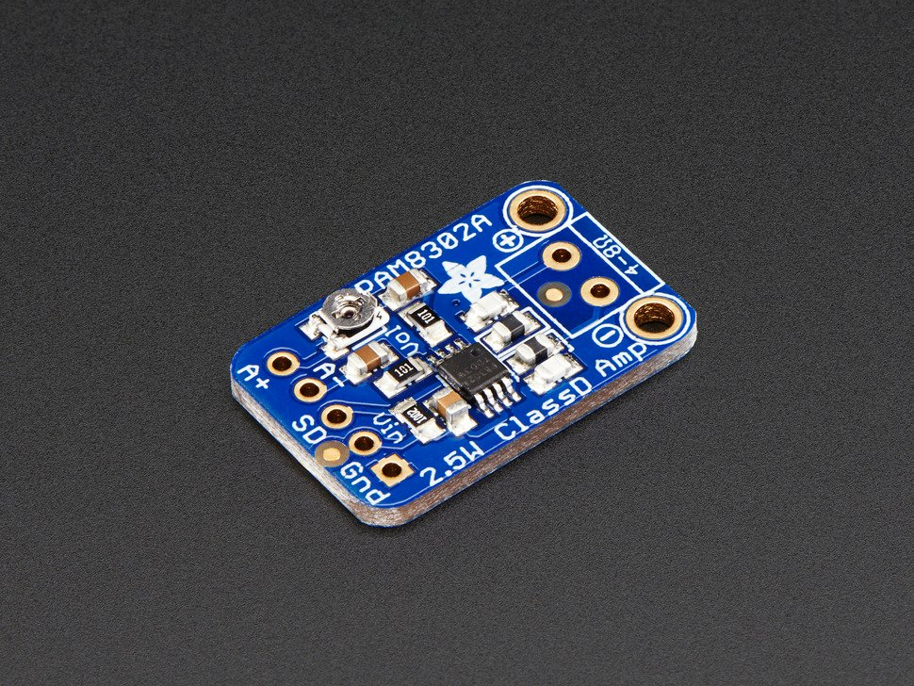
Amp
https://www.reichelt.de/de/en/developer-boards-audio-amplifier-class-d-pam8302a-debo-sound-amp1-p235505.html?PROVID=2788&gclid=Cj0KCQjwuMuRBhCJARIsAHXdnqNk4agOJo3q_V-EEzaXOEnxIQZ6iQGCj8q-KR24H9QsqF12Yn-0s_IaApU6EALw_wcB&&r=1
24 x 15 x 2 mm
Class D audio amp

Slide 6
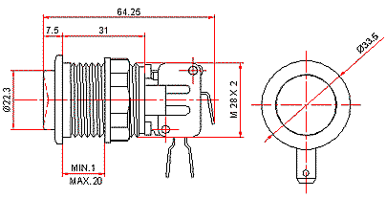
LARGE Button:
https://www.ozstick.com.au/information/useful-product-info/
Diameter of screw thread = ???
Hole in top plate should ideally have screw thread, if not, then make slightly larger and will just glue in place to hold.

Slide 7
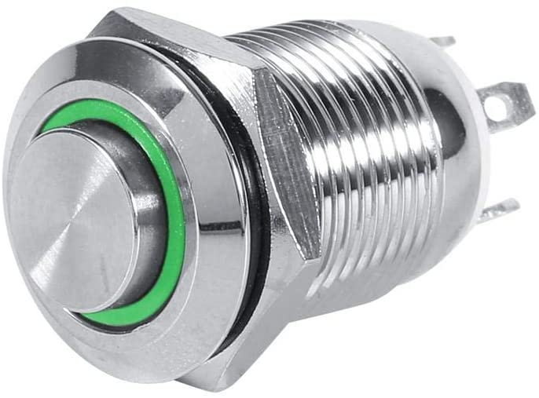
SMALL Button:
https://www.amazon.de/-/en/gp/product/B07XJY4VBQ/ref=ppx_yo_dt_b_search_asin_title?ie=UTF8&th=1

Slide 8
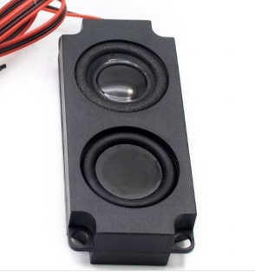
Loudspeaker
https://www.berrybase.de/raspberry-pi/raspberry-pi-computer/displays/8-ohm-5w-lautsprecher-passend-f-252-r-waveshare-displays?sPartner=g_shopping&gclid=Cj0KCQiApL2QBhC8ARIsAGMm-KH6kq9ZmpYTb-jLkTrJjl6RPikgvAl0aNnh8y3iC_yK5_bUrXXG-RcaAvE0EALw_wcB&c=56
100 x 45 x 21mm
Note 4 corner screw-holes are half-way in height

Slide 9
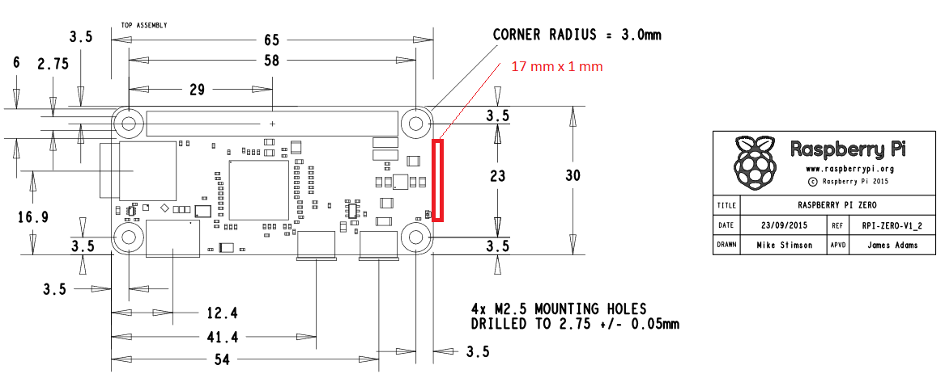
Pi Zero
66.0mm x 30.5mm x 5.0mm
Board should be offset to give access to USB ports

Slide 10
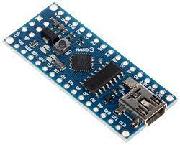
ATmega328p
https://www.amazon.de/-/en/gp/product/B0755XYBG4/ref=ppx_yo_dt_b_search_asin_image?ie=UTF8&th=1
45 x 17,5 x 18 mm

Slide 11
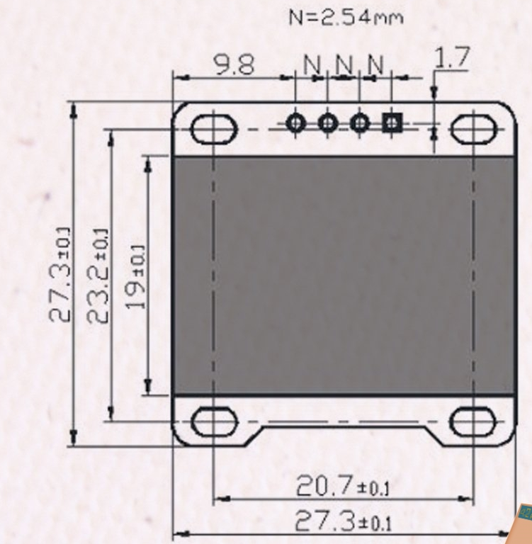
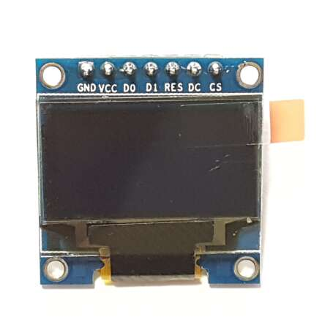
OLED
OLED Display I2C 128 x 64 Pixel I2C
https://www.az-delivery.de/en/products/0-96zolldisplay

Slide 12
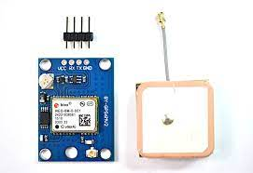
GPS
NEO M-9N
https://www.amazon.de/dp/B088LR3488?ref_=pe_3044161_248799201_302_E_DDE_dt_1
NB is board and patch antenna.
Board = 26x36mm
Patch antenna = 25x25 mm

Slide 13
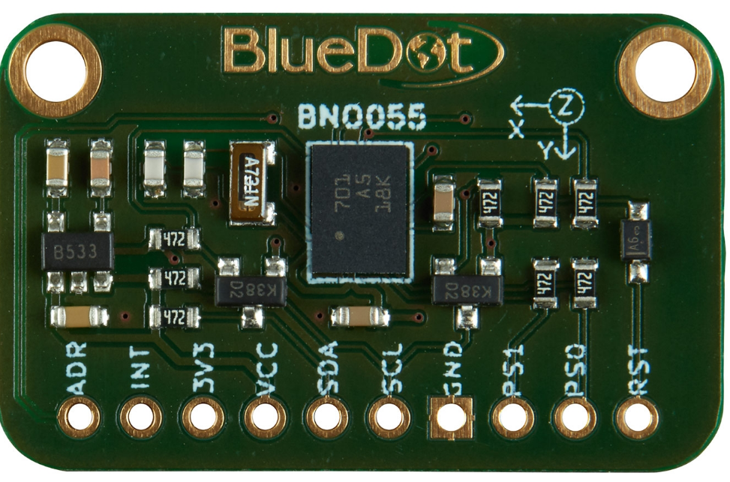
IMU
https://www.bluedot.space/products/bno055/
30*19*2 mm (NB connector pins are approx 4 mm)
Mounting holes

Slide 14
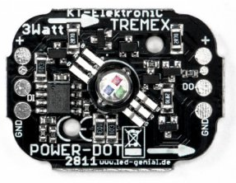
PLED (Programmable LED)
Power-Dot 3W, WS2811
https://www.led-genial.de/Power-Dot-3W-WS2811-kompatibel
32 x 25mm
Mounting holes

Slide 15
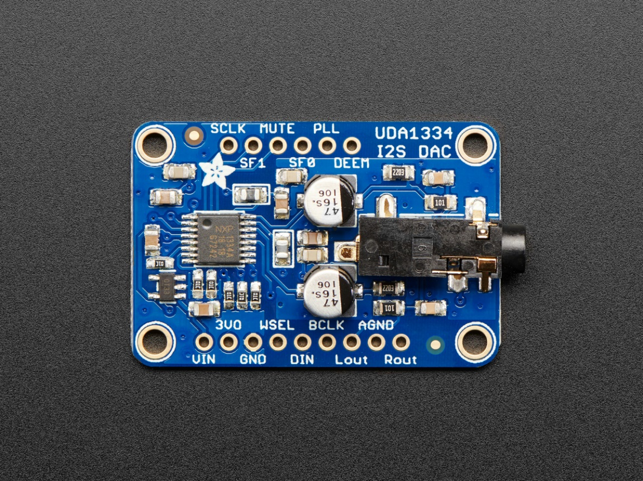
I2S Audio
Adafruit I2S Stereo Decoder - UDA1334A
https://www.adafruit.com/product/3678
Product Dimensions: 40.0mm x 25.0mm x 7.1mm

Slide 16
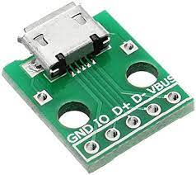
Micro USB connector
https://www.amazon.de/dp/B07W13X3TD?ref_=pe_27091401_487187591_302_E_DDE_dt_1
10 x 5 x 0.5 cm

Slide 17
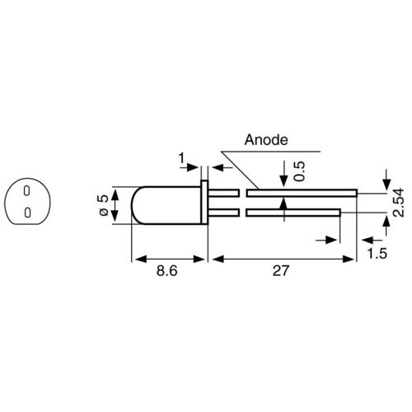
Standard LED

